Slide 1


Slide 2
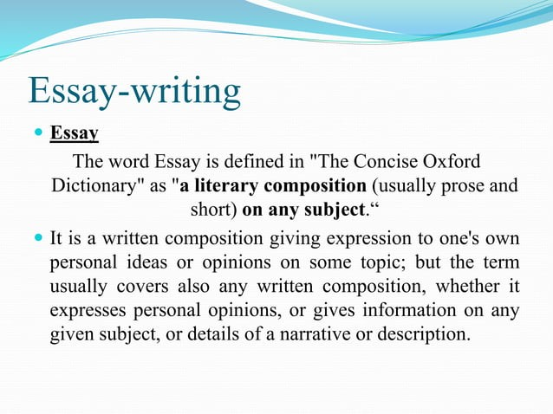

Slide 3
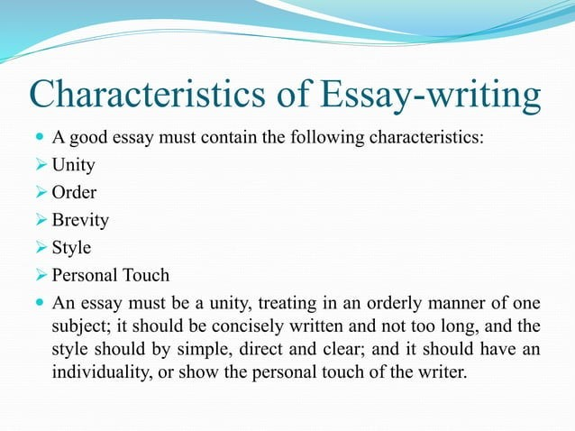

Slide 4
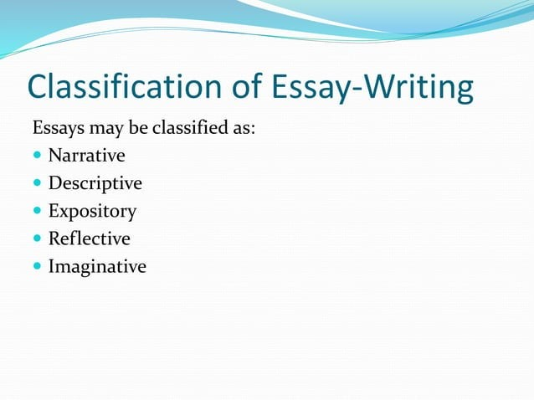

Slide 5
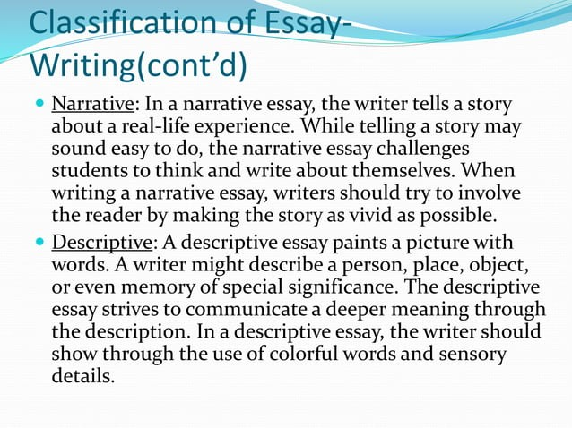

Slide 6
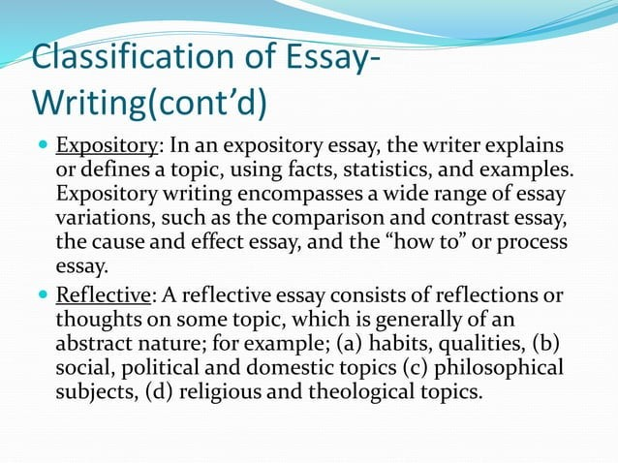

Slide 7
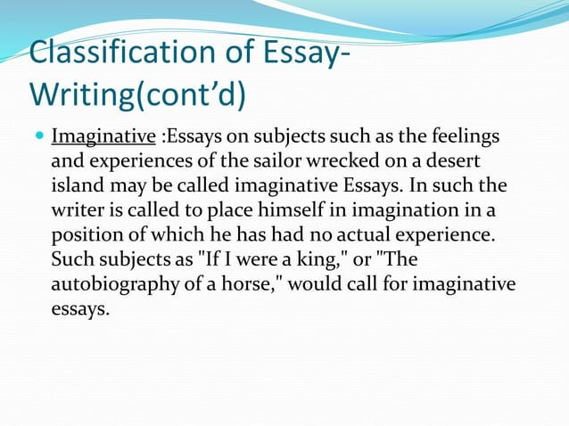

Slide 8
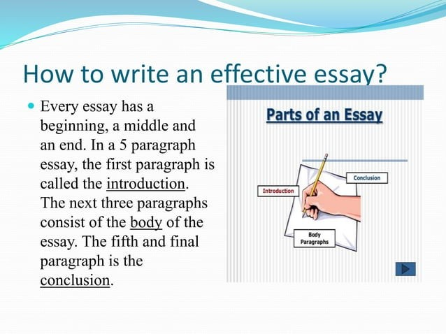

Slide 9
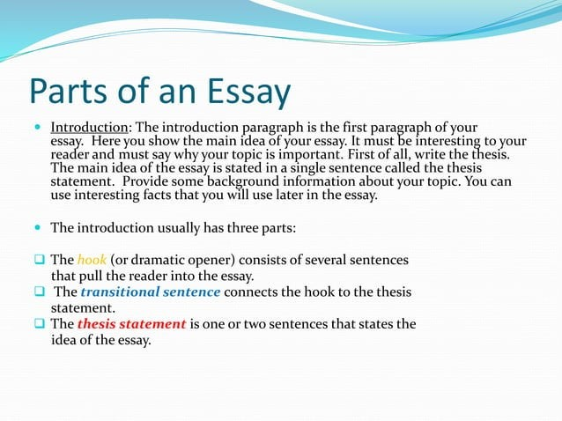

Slide 10
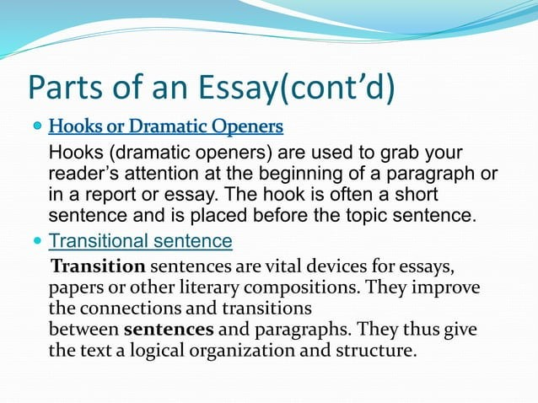

Slide 11
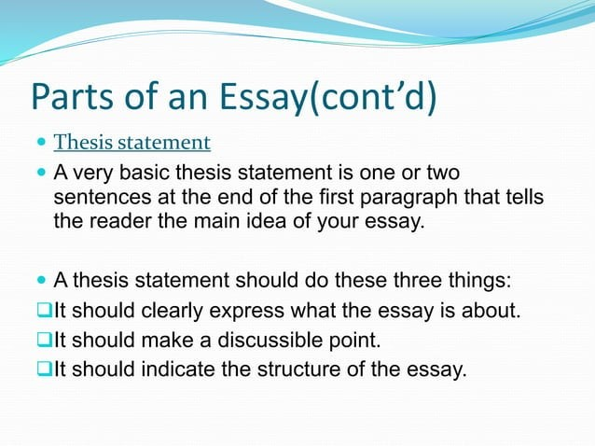

Slide 12
Essay on Election
Hook sentence: "Did you know that in the last presidential election, nearly 100 million eligible voters did not cast a ballot?"
Transitional Sentence: "This shocking statistic highlights the importance of addressing the issue of low voter turnout, which emphasizes the need for all citizens to take part in the democratic process through voting, as it is vital to fostering a just and equitable society."
Thesis statement: "Therefore, it is essential for all citizens to exercise their right to vote in order to ensure a fair and democratic society."
Essay on Social Media
Hook sentence: "Is social media helping us stay connected or driving us apart?"
Thesis statement: "While social media has the potential to bring people together, the negative impact of its overuse on mental health and relationships cannot be ignored."

Slide 13
Essay on The Best Town I Have Visited
Hook sentence: "As I stepped off the train, the scent of freshly-baked bread and coffee wafted through the air."
Transitional Sentence: "The warm and inviting aroma that greeted me upon my arrival in this small European town was just a taste of the many delightful experiences to come, as its charming cafes and quaint streets offer a peaceful retreat for travelers seeking a relaxing getaway".
Thesis Statement: "Therefore, this town is the perfect destination for those looking to escape the hustle and bustle of everyday life and immerse themselves in a tranquil atmosphere".
Essay on Regular Exercise
Hook sentence: "Did you know that regular exercise can reduce your risk of chronic diseases such as heart disease and diabetes?"
Transitional Sentence: "The significant impact that regular exercise can have on reducing the risk of chronic diseases highlights the importance of prioritizing physical activity in our daily lives, as it is a key component in achieving optimal health and well-being."
Thesis Statement: "By incorporating regular exercise into their daily routine, individuals can improve their overall health and well-being, leading to a more fulfilling and active lifestyle."

Slide 14
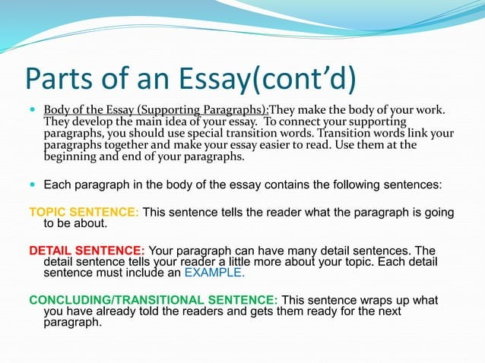

Slide 15
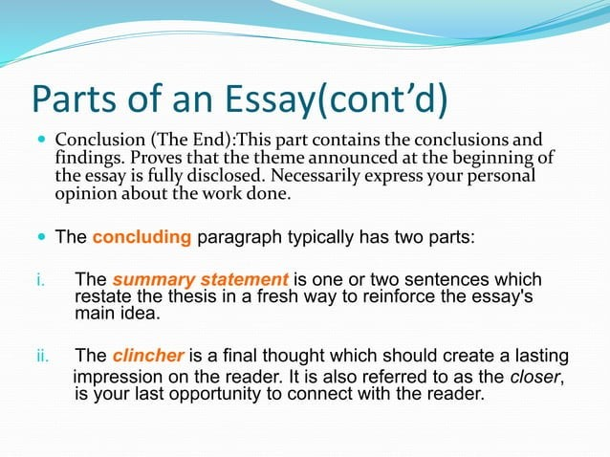

Slide 16
Example of an Essay (Balanced Diet)
Are you someone who finds yourself constantly reaching for junk food and other unhealthy options just for the taste, without considering the impact on your body? The reality is that many people prioritize taste over health and neglect to nourish their bodies with the proper nutrients, resulting in negative consequences on their overall well-being. It is crucial for individuals to recognize the importance of a balanced diet, not only to reduce stress and promote a healthy lifestyle, but also to ensure optimal physical and mental health.
A diet that contains all kinds of necessary ingredients in almost the required quantity is called the “Balanced Diet”. A Balanced diet is one that helps to maintain or improve overall health. We should consume a balanced diet consisting of essential nutrition: liquids, adequate proteins, essential fatty acids, vitamins, minerals, and calories. We must eat fresh fruits, salad, green leafy vegetables, milk, egg, yogurt, etc. on time in order to maintain a healthy body.

Slide 17
Among the minerals, we require chiefly iron, calcium, sodium, potassium, and small quantities of iodine, copper, etc. They are found in green vegetables and most fruits, Vitamins have a number of kinds like A, B, C, D, etc. Vitamin A is found in fish oil, butter, carrot, papaya, etc., and Vitamin B is found in green leafy vegetables, wheat grain, etc. Vitamin C is found in green chilli, green vegetables, amla, lemon, and citric fruits. Vitamin D is found in the first oil, butter, and rays of the sun. We also need Vitamins E and K for our health. Milk is perhaps the only single item that can be called a balanced diet in itself.
Animal protein is found in meats, poultry, and fish. The white of an egg also contains protein. Another kind of protein is found in milk (casein), cheese, curd, pulses, soybean, dry fruits, etc. Fat is found in butter, coconut, all edible oils, cod liver oil, the yolk of an egg, etc.
We should eat only fresh, well-washed and well-cooked food articles which are free from dust and flies. Fried foods and foods containing excess fat, spices, and chillis are harmful. Roadside eating should be avoided. We should take the last meal two or three hours before going to bed. There should be a good time gap between two meals so that the food gets digested in our stomachs.

Slide 18
A healthy body also needs some daily physical activities, proper rest and sleep neatness, a healthy environment, fresh air, and water, personal hygiene, etc. Also, we should drink more water at least 7-8 glasses of water. It balances blood pressure and supplies vital nutrients exceptionally quickly to the body. A fit and healthy individual turns out to be more resistant to infections and diseases.
Wealth matters, but, is not as important as health. Spending lots of money on junk food in five-star hotels or on other entertainment sources like watching films for a day and so on has no advantages other than self-satisfaction. Being physically and mentally healthy helps an individual to be socially and financially healthy as well.

